Slide 1
Grand Challenges & Potentials of Ethiopia’s Water Resources by 2050
By Eyob Berhane & Yilma Mengistu
Dec. 19, 2019, Addis Ababa

Slide 2
Contents
Abstract
Surface Water Potential of Ethiopia
Land and Water Resource Challenges and Potential
Present and Future Challenges of the Water Resource Sector
Conclusion
Recommendations

Slide 3
1. Introduction
Though Ethiopia is endowed with substantial amount of surface and ground water, presently it is facing acute shortage of food, water supply for industrial and consumptive use. This is mainly due to lack of attention to harness the country’s surface and ground water by the Government.
Population growth, urbanization and industrial growth yet pose a great challenge at present and in the coming 40years. Equivalent with this most of the rivers that originate from the highland of Ethiopia culminate in to neighboring countries, needless to mention the necessity for prudent planning and equitable utilization of the resource with neighboring countries in the horn of Africa.
Unless the government give due attention for the development of the country’s water resources the problem will continue and will reach a critical level by 2050. Further, with a population of about 200 million, by 2050, the demand for water and food security will reach a dangerous stage where water will be the center of gravity for Ethiopia’s politics.

Slide 4
1. Introduction
Historically modern water resource development for water supply, hydropower and irrigated agriculture is not new to Ethiopia. Among others, during the imperial era large scale irrigation projects such as Wonji, Metehara and Amibara had been implemented and were benchmarks to encourage the Derg government to start additional large scale projects like Angelele Bolhamo, MelkaWakena hydroelectric dam and Gode irrigation projects. Subsequently, we are witnessing the aggressive action of the present government in developing huge irrigation projects like Tendaho, Kessem, Kuraz and Omo. Parallel with these, hydroelectric projects like, Tekeze, Gibe-I,II& III as well as cascade of hydro power projects on Genale river and the Grand Renaissance dam on Abay river are under construction.
Ever since the draught of the early 70s the government had been striving to harness the water resource potential of the nation. To date, the major river basins of the country had been studied at a master plan level. Although at snail speed, the nation has started to utilize this important and significant resource for the wellbeing of its people (particularly for water supply and irrigation).
Despite having great water resource potential in many parts of the nation acute shortage of water is observed be it for domestic consumption, irrigation and other uses. This situation is worse in the arid and semi-arid areas like the Ogaden, Afar and other dry basins.

Slide 5
1. Introduction
Most of the country is rural with weak town structure. From what we are witnessing, in the coming 40 years built-up areas and towns will grow tremendously. Whatever new rural development strategies are implemented traditional agriculture alone cannot solve existing demographic issues.
With this regard, what is at stake in the coming 40 years is the presence of good professionals at all levels and having reliable data at their disposal. Implementation of water resources projects depends on financial and managerial potential in regional and federal governments. If this does not exist no project can be properly planned, executed and operated.
Sustainable development is based on human potential and human potential can only be mobilized through proper training and information. It is here where the nation’s education system should be geared towards the need of the industry.
In this paper it is attempted to bring one of the grand challenges of the nation by 2050, “Water Resource” at the front so that policy and decision makers could have an insight on this significant natural resource its challenges and potentials by 2050.
This paper is prepared based on secondary data and information. Except for some empirical and first hand information from the author, the paper is based on the various river basin master plan study documents and works of other senior professionals.

Slide 6
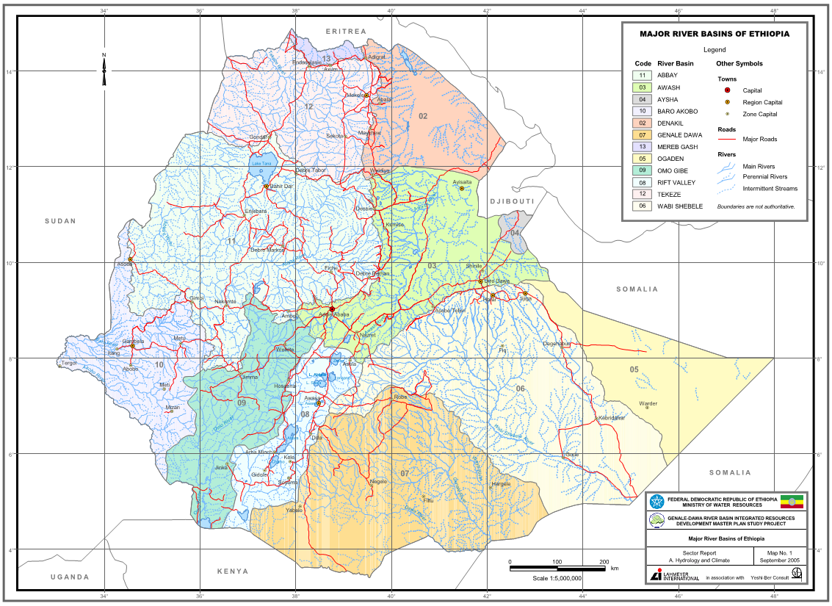
2. Surface Water Potential of Ethiopia The total area of the country is drained by 10 wet natural drainage channels (rivers) and some part of the nation literally have no or little runoff and are termed as dry basins. The three dry basins are; Ogaden, Denakel and Aysha. Figure-1 shows the major river basins of Ethiopia.
Reproduced from Genale-Dawa River Basin Integrated Resources Devt..... Master Plan Study(YWSHI-BER CONSULT/LHMEYER Int. 2005)
Figure-1, Major River Basins of Ethiopia

Slide 7
The annual flow in the major rivers stand at 111.62 billion m³. The 75% reliable flow from these rivers is 99.8 billion m³. In the coming 40 years the water service demand is estimated to be 79 billion m³ out of these 54 billion m³ is for water consumption(Tesfaye Gizaw etal.). Table-1 gives the drainage area of each basin and the available 75% dependable flow in the rivers.
Table-1, Basin Wise Drainage Area, Gross Flow and 75% Dependable Flow
No | River Basin | Area (km²) | Available Surface Water (Bm³)
 |  |  | MAF | 75% Dependable Flow
1 | Abbay | 201,346 | 52.62 | 51.48
2 | Rift Valley | 57,739 | 5.64 | 4.36
3 | Awash | 112,696 | 4.6 | 4.10
4 | Omo-Gibe | 78,213 | 17.96 | 14.46
5 | Genale-Dawa | 171,042 | 5.88 | 4.58
6 | Wabi-Shebelle | 202,697 | 3.16 | 2.34
7 | Baro-Akobo | 74,102 | 11.81 | 8.51
8 | Tekeze | 90,001 | 7.63 | 5.73
9 | Mereb-Gash | 10,500 | 0.53 | 0.42
10 | Ogaden | 77,121 | - | -
11 | Denakil | 74,002 | 0.86 | 0.57
12 | Aysha | 2,223 | - | -
 | Total | 1,151,682 | 110.69 | 96.55

Slide 8
Present and Future Challenges of the Water Resource Sector
No. | River Basin | 75% Dependable Flow (Bm³) | Identified Major & Medium Projects |  | Potential Hydropower Projects
 |  |  | Irrigable Area (ha) | Annual Irrigation Requirement (Mm³) | Potential (GWh/yr)
1 | Abbay | 51.48 | 1,001,550 | 8,420 | 78,820
2 | Rift Valley | 4.36 | 139,300 | 1,249 | 800
3 | Awash | 4.10 | 205,400 | 4,100 | 4,470
4 | Omo-Gibe | 14.46 | 445,320 | 1,188 | 36,560
5 | Genale-Dawa | 4.58 | 423,300 | 4,583 | 9,270
6 | Wabi-Shebelle | 2.34 | 204,000 | 2,545 | 5,440
7 | Baro-Akobo | 8.51 | 905,500 | 6,873 | 18,800
8 | Tekeze | 5.73 | 312,700 | 3,717 | 5,980
9 | Mereb-Gash |  | 67,500 | 844 | 760
10 | Ogaden | - | - | - | -
11 | Denakil | 0.57 | - | - | -
12 | Aysha | - | - | - | -
 | Total | 96.55 | 3,704,571 | 33,519 | 160,900
Table-2, Basin-Wise Potential Irrigation And Hydropower Projects
Reproduced from Draft Integrated River Basin Master of Ethiopia, WAPPCOS/EVDSA 1994, & modified to suite this paper

Slide 9
Table-3, Potential Production Loss due to Erosion
Crop | Loss in Equivalent ha/yr | Loss in Production Value Million Birr/yr
Wheat | 272,727 | 393
Cotton | 104,895 | 397
Sugar | 151,515 | 1033
Reproduced from Draft Integrated River Basin Master of Ethiopia, WAPPCOS/EVDSA 1994, & modified to suite this paper
The fishery development in the country is at an all-time low. The fish production from lakes and rivers has declined from 25,000 tons per year in 1950 to just 1,083 tons in 1988. The per capita annual fish consumption in the country is less than 100 grams. It has been estimated that the fish potential from existing lakes and rivers is 38,000 tons per year (WAPPCOS/EVDSA 1994).
In many basins, the wildlife reserve areas conflict with the irrigable command areas of proposed irrigation projects and/or reservoir areas of large dams. The Government will have to decide as to what use should these areas be ultimately put to.

Slide 10
3. Land and Water Resource Challenges and Potential
About 13.5 % area of the country is highly to moderately suitable to irrigated agriculture. This works out to about 17 million ha. Another 38 million ha is marginally suitable. However, the availability of water at the right location restricts the irrigable area to about 3.7 million ha as identified to be under the command of major and medium irrigation projects. The presently cultivated area in the country, mostly rain fed, is about 21.3%, or 26.5 million ha as worked out by FAO Land Use and Land Cover maps (1984).
The total loss of top soil in Ethiopia through erosion has been estimated as 3 billion tons per year(WAPPCOS/EVDSA 1994). In other words, on an average, the entire surface area of the country losses 2 mm of soil every year or 1 cm every 5 years. Some areas loose as much as 25 mm per year. The nutrient value of this soil loss is equivalent to 150,000 tons of fertilizers every year or about one and half times the total annual import of fertilizers in the country. The value of the nutrient loss is about 250 million Birr per year, at 1994 exchange rate. The worst affected area in the country is about 46 million ha out of which 21.5 million ha is presently cultivated. In other words, more than 80 % of the presently cultivated area is suffering from soil erosion.
In addition to this deficit due to nutrient loss the loss in potential production is as shown in Table-3.

Slide 11
Urban & Rural Water supply Country present status & 2050 expected requirements
As stated above Ethiopia has about 122 Billion cubic meters of surface water and about 5 to 6 Billion cubic meter of ground water potential. Less than 5% of the available water resource potential is utilized so far, out of which only around 10% is utilized for domestic consumption.
By 2050, about 650 cubic meters of water would be available for Ethiopians per capita per annum. The existing per capita availability of water resource is about 1250 cubic meters per annum.
Considerable portion of people of Ethiopia do not have access to safe and potable water, and around 95% percent of the population do not have access to modern improved sanitation systems such as modern latrines.
The objective of the WaSH program is to provide 15 liters per capita per day with in 1.5km walking distance for rural population and 20 liters of water per capita per day with in 0.5 km walking distance for the urban population. Despite the government’s effort to meet the Millennium Development Goal (MDG) target for water supply provision to the rural community, the rural community is by far deprived of the minimal water supply provion enjoyed by the global community at large.

Slide 12
Hand Pumps

Slide 13
Solar Powered Deep Well Pump for Rural Water Supply

Slide 14
Rural water supply storage and distribution

Slide 15
4.Present and Future Challenges of the Water Resource Sector
The need for the control, conservation and equitable distribution of Ethiopia’s vital water resources has reached critical stage as the demand for water is mounting due to population growth, urbanization and industrialization. These problems are not new and are in existence since the serious drought of the early 70s. However, never before have they reached such widespread and serious magnitudes as of today compared to the early 70 and will exponentially escalate in the coming 40 years. The super critical nature of the problem emanates not only from the high population growth rate, expansion of industry, and agriculture, but also from the consequences of a long period during which no tangible water related projects been implemented and no coordinated biological and engineering interventions to conserve soil and water has kept pace with the increased need for additional environmental protections that could augment the water resource. Unless corrective measures are taken immediately the far-reaching negative consequences will be disastrous.
At this junction it would be prudent to indicate though not so spectacular, but nonetheless significant, and constantly evident, is the problem of water deficiency in many areas of the country. A critical need for supplemental water supply now is evident in many areas, including teagarden, Afar and other arid and semiarid areas of the country.

Slide 16
4.Present and Future Challenges of the Water Resource Sector
In the near future there is no indication for the slowdown of population growth and a bulk amount of water is needed for irrigation, power, urban and domestic use.
Without a shadow of doubt the need for the solution of the present and future water problem of Ethiopia should be the major agenda of the government. It is also clear from a study of the past history of water development in the country that its future growth will depend upon a coordinated nationwide program for water development of the nation. This implies an urgent need for the planning and construction of water resources development projects.
At present the wet basins of the nation are studied at a master plan level and a preliminary water resources development master plan for Ethiopia was compiled in the early 90s. On the outset this nationwide preliminary master plan should be updated to a final nationwide master plan based on the findings of the recently completed basin wise master plan studies. This way decision and policy makers will find the water resources of the nation consolidated in one place.

Slide 17
Conclusion
Population growth, industrialization, urbanization and food security are the major challenges that the nation faces. Unless proper actions are taken now, these predicaments will continue to be major challenges of the nation in the coming 40years.
Rapid growth of Ethiopia’s population is a good indicator for the need of integrated planning and utilization of its natural resources in a sustainable manner. In the late 70’s the population of Ethiopia was about 36 million, in 1990 the population was about 50 million and currently the population is estimated to be 100 million and will reach 190 million by the year 2050.
With 3.7 million hectares of irrigable land, a potential to produce 212,810 GW hydropower per annum, prospects with 1,990 Km of navigable water course, Ethiopia’s water resource potential stands among the leading in Africa. The nation is endowed with 2.6 billion m³ ground water(Draft Integrated River Basin Master of Ethiopia, WAPPCOS 1994, Dr. Zewde Abate etal.).The annual flow in the major rivers stand at 111.62 billion m³. The 75% reliable flow from these rivers is 99.8 billion m³. In the coming 40 years the water service demand is estimated to be 79 billion m3 out of these 54 billion m3 is for water consumption(Tesfaye Gizaw etal.).
Ethiopia is presently faced with problems of a highly critical nature - the need for further control, protection, conservation, and distribution of her most vital resource-water. While these problems are not new, having been existent ever since the advent of the drought of the 70s, never before have they reached such widespread and serious proportions. Their critical nature stems not only from the high population growth rate, relative expansion of industry, and agriculture in a drought stricken country, but also from the consequences of a long period during which the construction of water conservation works has not kept pace with the increased need for additional water. Unless corrective action is taken-and taken immediately-the consequences may be disastrous

Slide 18
Conclusion
On the outset the available nationwide preliminary master plan should be updated to a final nationwide master plan based on the findings of the recently completed basin wise master plan studies.
Parallel with the preparation of the final nationwide water resources master plan, design standards and code of practices should be prepared.
Based on the final nationwide master plan findings, prioritized water projects should be studied and designed according to the national standard and code of practice.
Few irrigation projects have been found to be economically viable in the past in Ethiopia. The evaluation has so far been done with certain assumptions and constraints. It is suggested alternative scenarios for financial analysis be setup with gradually relaxing constraints. It will rest on the government’s decision as to what extent it is prepared to relax the present controls to make a project financially viable.

Slide 19
Conclusion
The nationwide water resources development Master Plan will give the basic ingredients for decision and policy makers. Among others the nationwide water resources development master plan will;
Evaluates the water supply available to a country and describes the places and characteristics of its occurrence.
Estimates the water requirements, both present and future, for all purposes for each area of the country, as best as can be foreseen.
Points out the watersheds where present estimates indicate the existence of surplus waters over and above the future needs for local development, and gives an estimate of such surplus, and indicates the areas of deficiency and the estimated deficiency for each such area.
It outlines existing and prospective water problems in each area of a country. It indicates hydro-power potentials of the country.
It intimates that development of projects should have acceptable environmental impacts, mitigation measures and damage compensation strategies.
It suggests the manner in which the waters of a country should be distributed for the benefit and use of all areas.

Slide 20
Water Resources effective Utilization Recommendations
Without any delay state of the art project management and implementation system shall be put in place.
Soil and water conservation intervention should be implemented at a constant pace and the ongoing afforestation endeavor should be encouraged and strong monitoring and evaluation system should be in place.
The network of hydro-meteorological stations and river gauging stations should be proliferated and existing ones should be reestablished using state of the art instrumentation and data handling.
Regardless of ownership, government or private, all irrigation and water supply schemes to be implemented should have scheme administration units to look after operation and maintenance of the system.
The government should establish research stations at strategic location to prepare water application and water management standards.
A modern central information center should be established to provide information on the water and land resource of the country, to professionals, researchers, academicians and students.
The nation’s higher education system should be geared to produce sufficient number and able professionals that could tackle the grand challenge of the nation by 2050.

Slide 21
Rural & Urban Water Supply Provision Recommendations
Most rural water supply schemes are powered by diesel fuel, which makes running of the water supply schemes unaffordable to the beneficiaries rendering the schemes unsustainable. Hence Solar powered submersible and surface pumps are highly recommended to meet the increasing population demand and to ensure scheme sustainability.
Ground water level draw down during dry season directly affects the water provision in many parts of the country. Hence to counteract this the effective utilization of surface water in the form of constructing earth dams should be given due emphasis.
The country has to encourage the manufacture of good quality water pipes & fittings, and pumps and generators locally, instead of relying on imported ones that do not meet minimum material quality standards.
Water leakage in pipes should be reduced to a minimum acceptable values in cities and major towns. The major factors contributing to water supply system water loss are wearing and aging of pipes, operational problems of pumps that result in pressure surge, leakage of reservoirs and excavation activities by parties engaged in infrastructure development and maintenance projects.

